Slide 1

Case Study Of
NYKAA
Your Beauty. Our Passion.
ITVEDANT EDUCATION
DBMS QUERIES

Slide 2
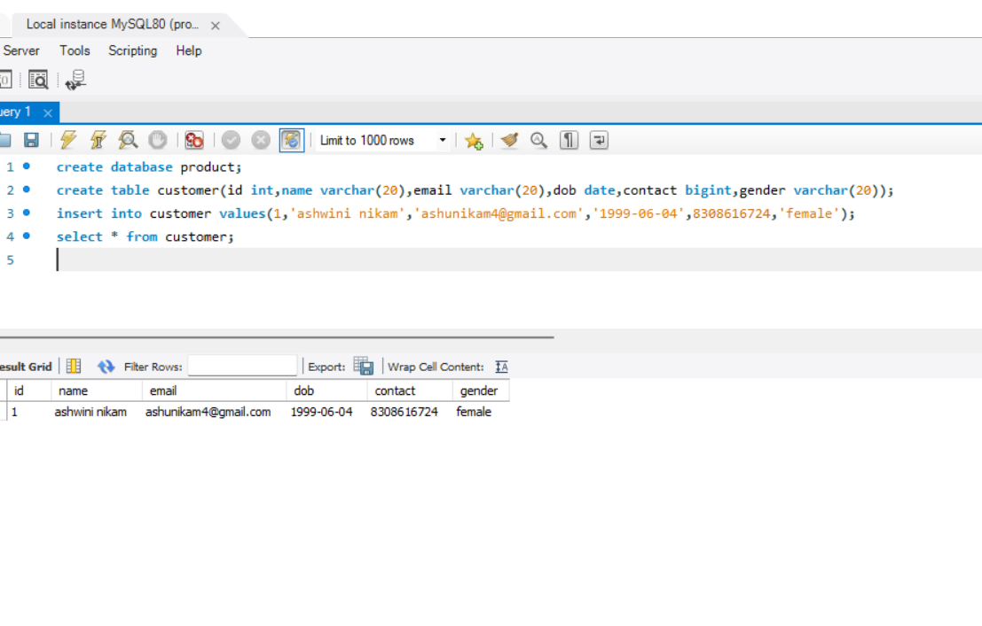
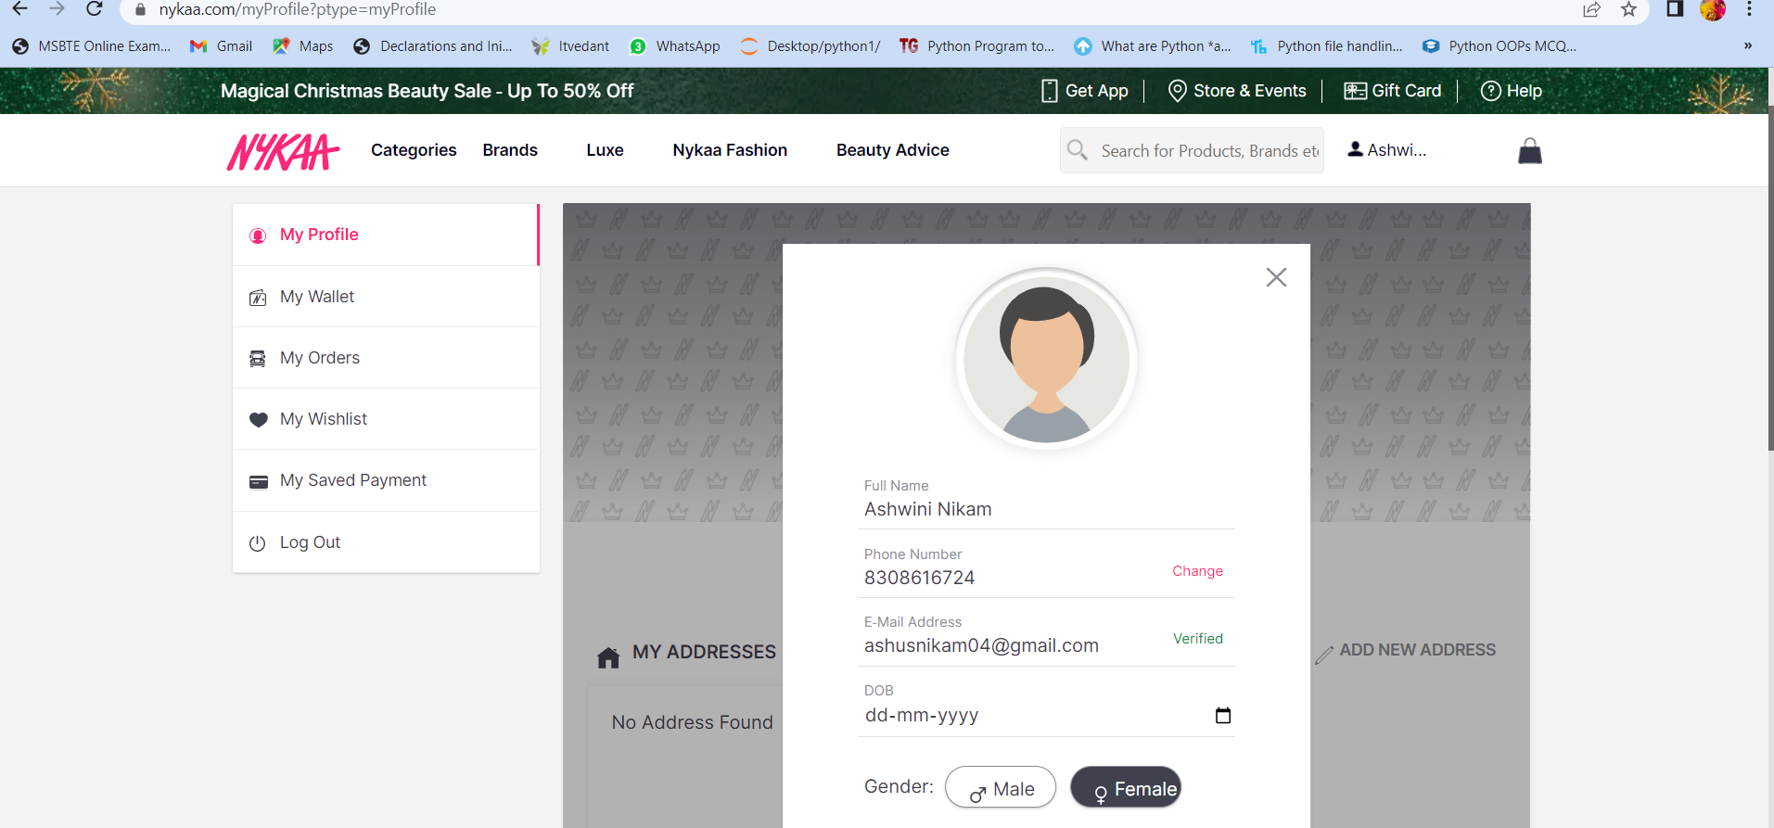
QUERY TO CREATE TABLE AND INSERT VALUES
TO CREATE DATABASE : create database product;
TO CREATE TABLE: create table customer(id int, name varchar(20),email varchar(20),dob date,contact bigint,gender varchar(20));
TO INSERT VALUES: insert into customer values(1,'ashwini nikam','ashunikam4@gmail.com','1999-06-04',8308616724,'female’);
TO SEE DATA IN TABLE: select * from customer;

Slide 3
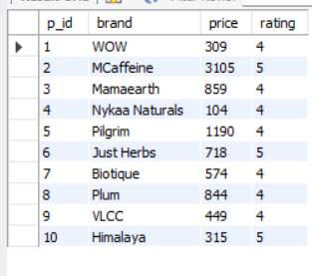
PRODUCT TABLE

Slide 4
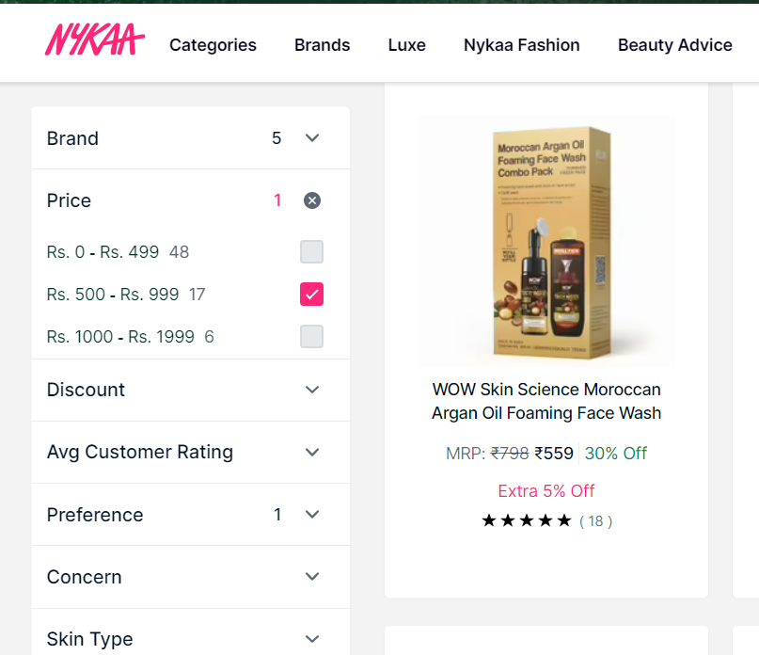
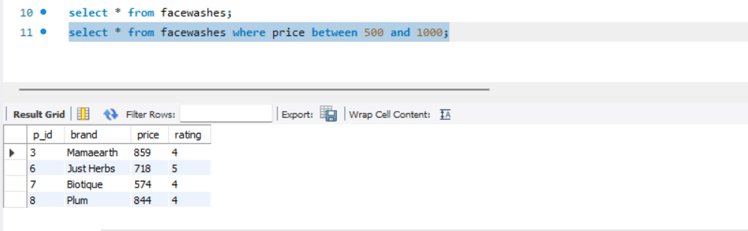
QUERY FOR APPLYING FILTER FOR PRICE BETWEEN 500 TO 1000
QUERY: select * from facewashes where price between 500 and 1000;

Slide 5
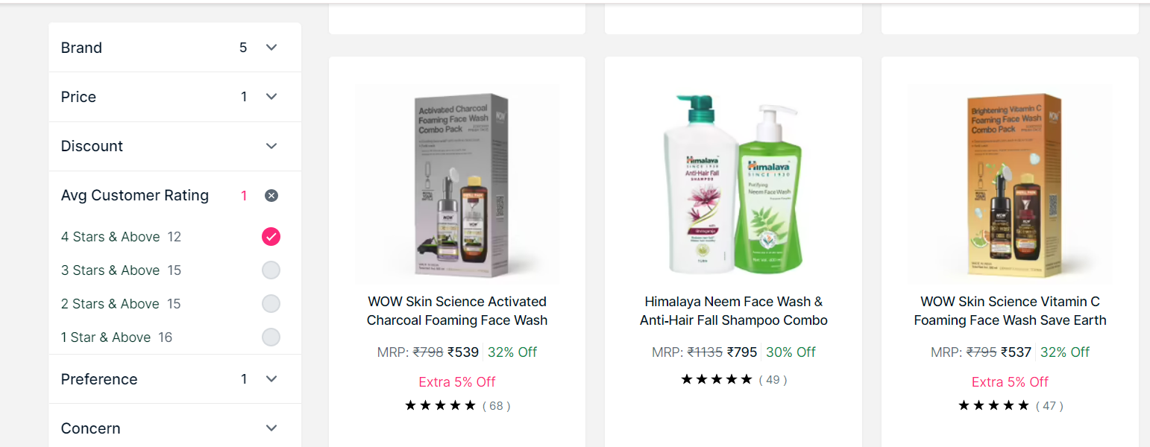
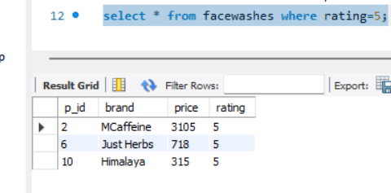
FILTER FOR CHOOSING BRAND
QUERY: select * from facewashes where rating=5;

Slide 6
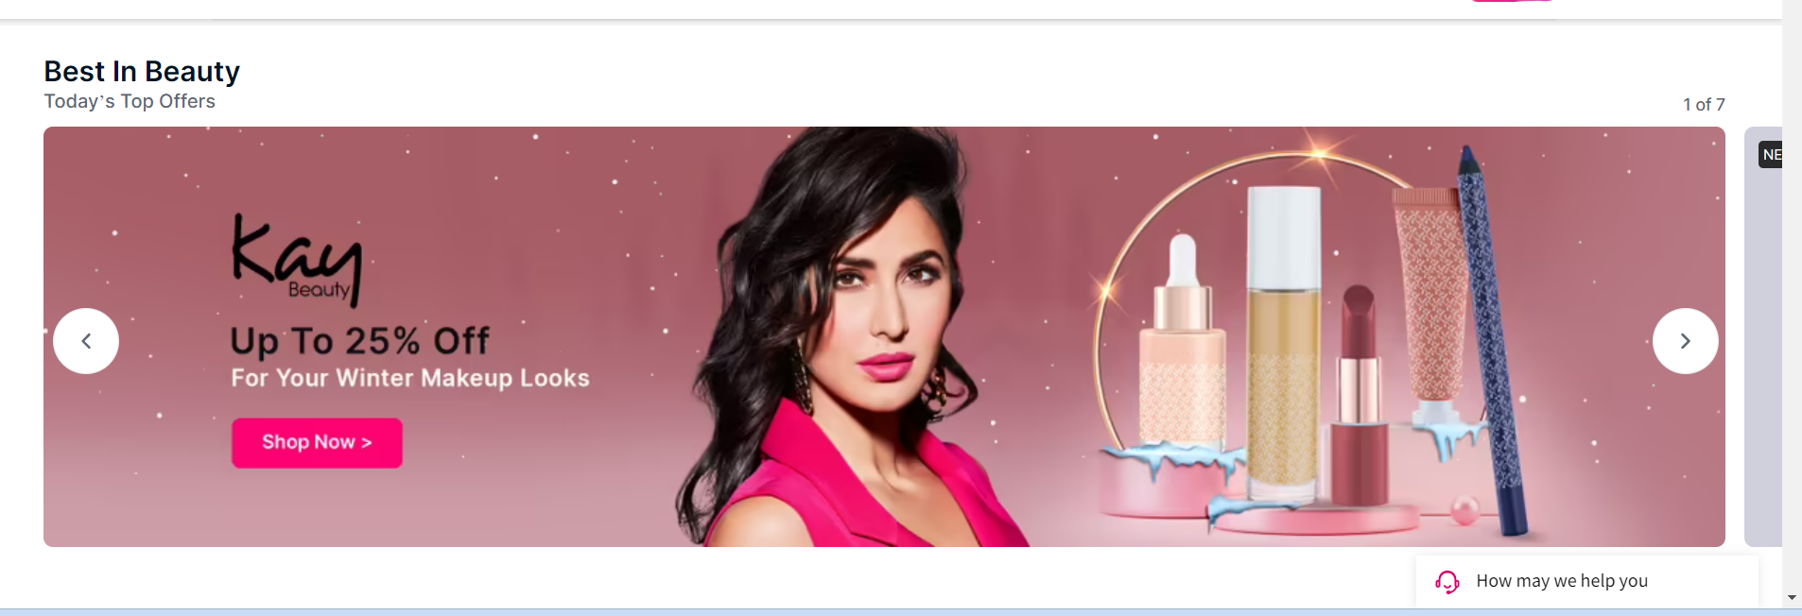
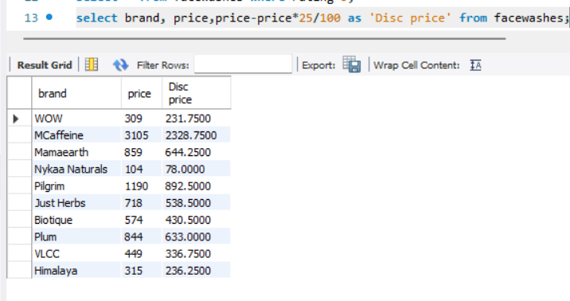
QUERY FOR APPLYING DISCOUNTS
QUERY: select brand, price , price-price*25/100 as 'Disc price' from facewashes;

Slide 7
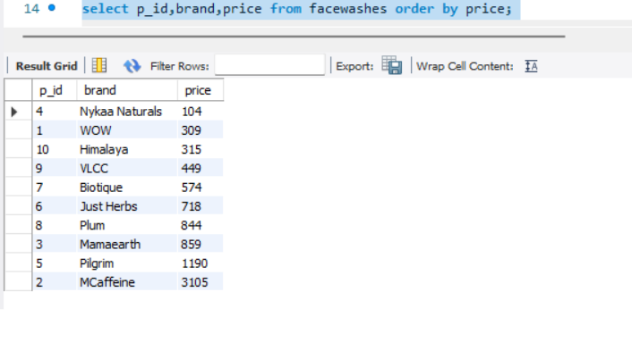
QUERY FOR ORDERING PRICE FROM LOWEST TO HIGHEST PRICE
QUERY:select p_id , brand , price from facewashes order by price;

Slide 8
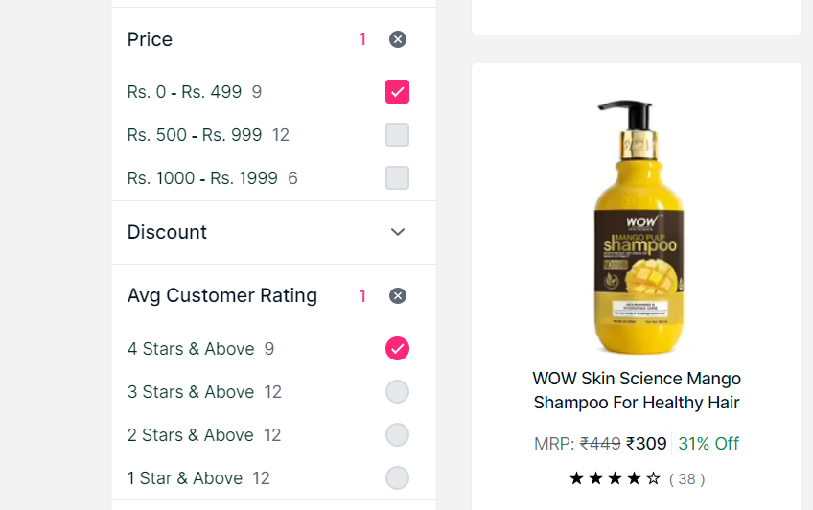
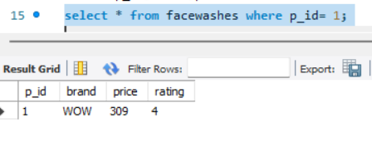
TO SELECT FACEWASH FOR OUR CHOICE
QUERY: select * from facewashes where p_id= 1;

Slide 9
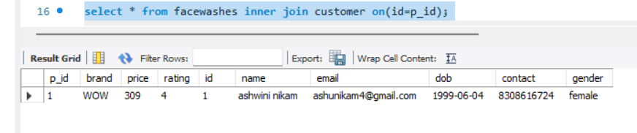
PLACING ORDER
JOINING FACEWASHES WITH CUSTOMER TABLE USING INNER JOIN QUERY
QUERY: select * from facewashes inner join customer on(id=p_id);

Slide 10
THANK YOU

